Slide 1

Project Scope Management

Slide 2
What is Project Scope Management?
Scope refers to all the work involved in creating the products of project.
Project scope management is the processes involved in defining and controlling what is or is not included in the project.
It is a process that helps in determining and documenting the list of all project goals, tasks, deliverables, deadlines, and budgets as a part of the planning process.
It is the process in w/c we can identify ,define and control output and benefits of project.

Slide 3
Contt..
Effective project scope management gives a clear idea about time, labor, and cost involved in the project.
It helps to distinguish between what is needed and what isn’t needed for accomplishing the project.
And used to manage scope properly that avoid scope creep and poor scope verification.
Project team/stakeholders must have same understanding of what products / deliverables will be produced as a result of a project and what process will be used in producing them.

Slide 4
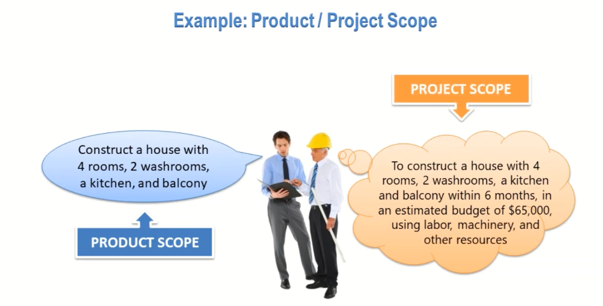
Contt..
Here sometime people confused with product scope and project scope.

Slide 5
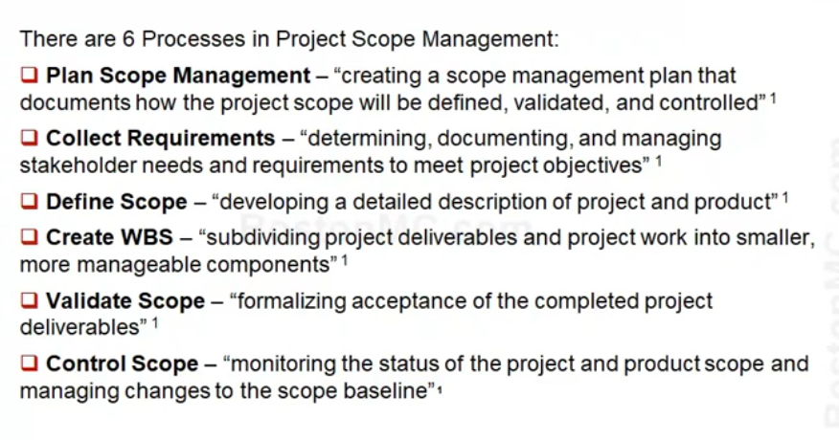
Project Scope Management Processes

Slide 6
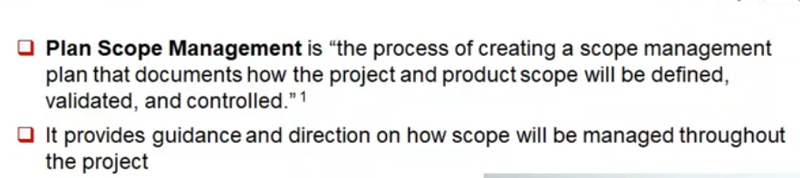
Planning Scope Management

Slide 7
Contt..
It is a document mainly helps in defining, managing, validating, and controlling project scope.
It includes:
  Detailed project scope statement
  Breakdown of all project requirements
  Expected project deliverables/output
  Change control process

Slide 8
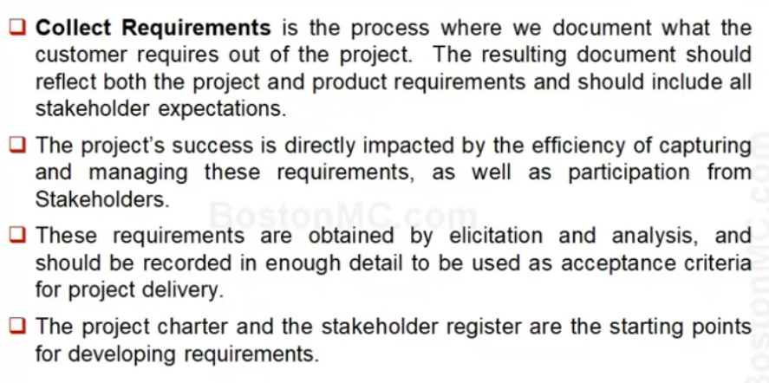
Collecting Requirements

Slide 9
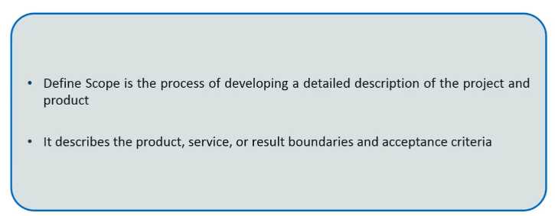
Defining the Scope

Slide 10
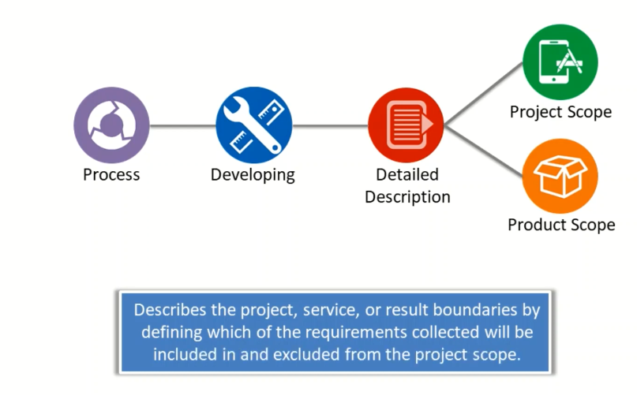
Contt..

Slide 11
Project Scope Statement(PSS)
PSS is also called scope document or statement of work(SOW).
PSS is output of defining scope process that specifies what work will be done and what work is excluded.
It is a document written by project manager, used to develop and confirm a common understanding of project scope among stakeholders.
It is a primary tool for stakeholders and teammates to refer back to and use as a guideline to accurately measure project success.
It should include:

Slide 12
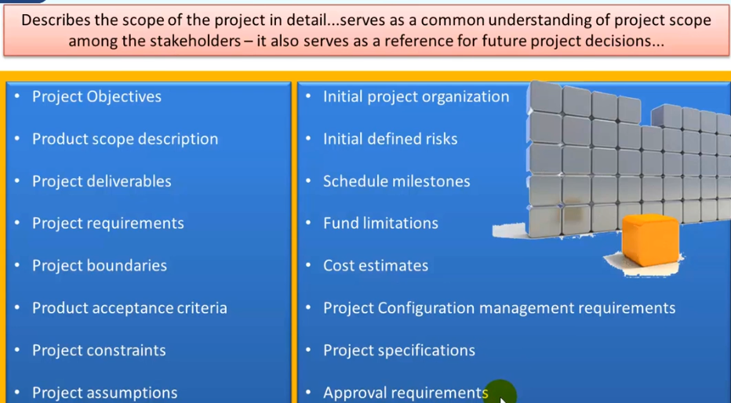
Contt…

Slide 13
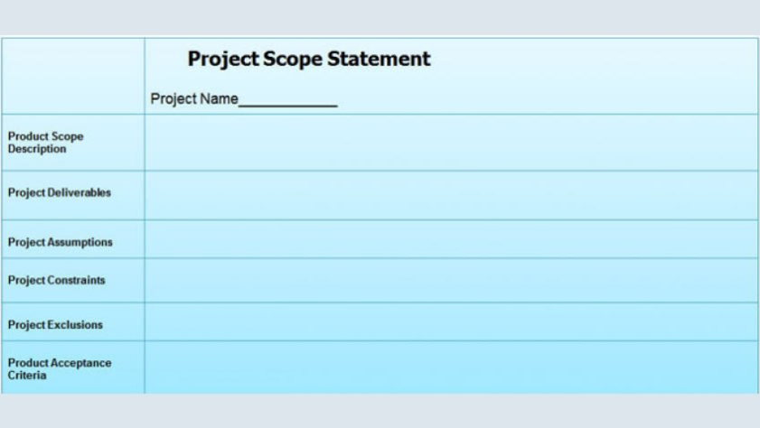
Simple of PSS

Slide 14
Create Work Breakdown Structure
The process of subdividing major project deliverables and project work into smaller, more manageable components.
WBS is a document that break down all the work which needs to be done in the project then assigns all tasks to the team members.
It is the most important process of scope management, B/c it is main output of the entire scope management knowledge area or leads to final scope baseline document.

Slide 15
Contt….
For an internal project, work is actually detailed in work breakdown structure (WBS) and WBS dictionary.
WBS dictionary is a document that provides detailed deliverables, activity and scheduling info about each component in the WBS.
WBS is an outcome-oriented analysis of work involved in a project that defines hierarchical decomposition of total scope of the project.

Slide 16
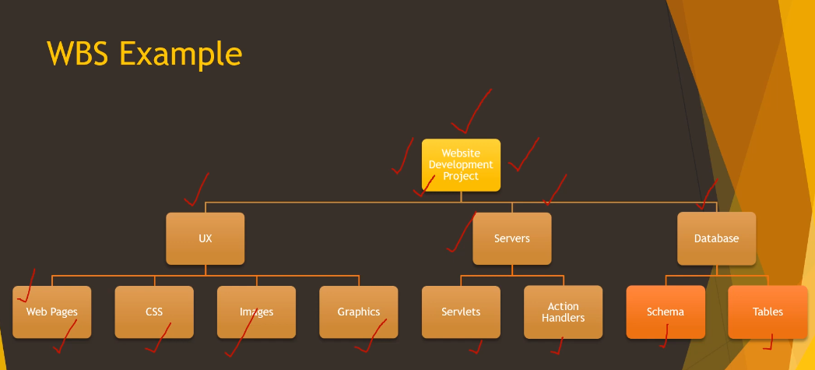
Decomposition of scope

Slide 17
Approaches to Developing WBSs
Using guidelines: Some organizations, like the DoD, provide guidelines for preparing WBSs
The analogy approach: It often helps to review WBSs of similar projects
The top-down approach: Start with the largest items of the project and keep breaking them down
The bottom-up approach: Start with the detailed tasks and roll them up

Slide 18
Validating scope
Validate scope is the process of formalizing acceptance of completed project deliverables.
It confirms that, stakeholders accept deliverables and are satisfied with final outcomes.
In this step, scope and deliverables that you have recorded need to be sent to project executives and stakeholders to get necessary approvals.
Scope validation required before starting the project to ensure that if something goes wrong then it is easy to find where it left wrong.

Slide 19
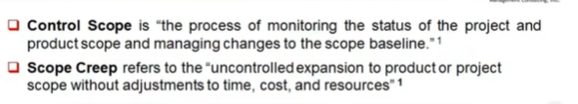
Scope Change Control

Slide 20
Contt …
Scope change control: Controlling changes to project scope.
Project managers need to ensure that as the project begins, it always stays within the defined scope.
But, in case there are some things that need to change, then proper change control process should be followed.

Slide 21
Identifying Potential Projects
Many organizations follow a planning process for selecting IT projects
First develop an IT strategic plan based on the organization’s overall strategic plan
Then perform a business area analysis
Then define potential projects
Then select IT projects and assign resources

Slide 22
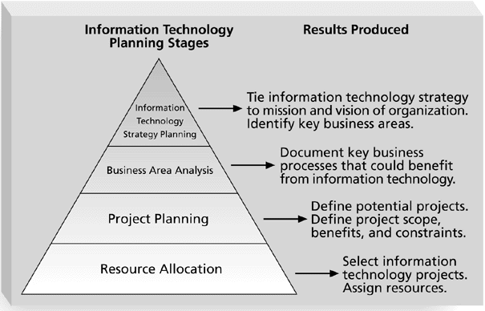
Information Technology Planning Process

Slide 23
Methods for Selecting Projects
There are usually more projects than available time and resources to implement them
It is important to follow a logical process for selecting IT projects to work on.
Methods include focusing on broad needs, categorizing projects, financial methods, and weighted scoring models

Slide 24
Focusing on Broad Organizational Needs
It is often difficult to provide strong justification for many IT projects, but everyone agrees they have a high value
Three important criteria for projects:
  There is a need for the project
  There are funds available
  There’s a strong will /willpower to make the project succeed

Slide 25
Categorizing Projects
One categorization is whether the project addresses
  a problem
  an opportunity, or
  a directive
Another categorization is how long it will take to do (time) and when it is needed.
Another is the overall priority of the project

Slide 26
Financial Analysis of Projects
Financial considerations are often an important consideration in selecting projects.
Three primary methods for determining the projected financial value of projects:
  Net present value (NPV) analysis
  Return on investment (ROI)
  Payback analysis

Slide 27
Net Present Value Analysis
Net present value (NPV) analysis is a method of calculating the expected net monetary gain or loss from a project by discounting all expected future cash inflows and outflows to the present point in time
Projects with a positive NPV should be considered if financial value is a key criterion
The higher the NPV, the better the project.

Slide 28
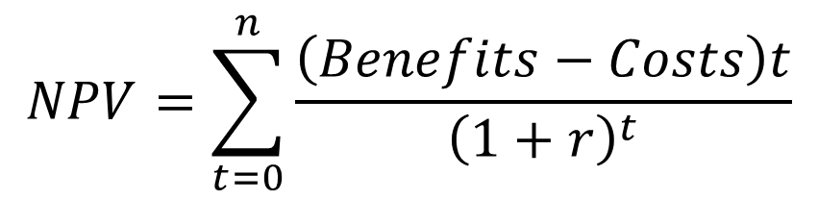
NPV can be computed using the following formula
Where:
r= discount rate
t= year
n= analysis horizon (in years)

Slide 29
Return on Investment
Return on investment (ROI) is income divided by investment
The higher the ROI, the better
Many organizations have a required rate of return or minimum acceptable rate of return on investment for projects

Slide 30
Payback Analysis
Another important financial consideration is payback analysis
The payback period is the amount of time it will take to recoup, in the form of net cash inflows, the net dollars invested in a project
Payback occurs when the cumulative discounted benefits and costs are greater than zero
Many organizations want IT projects to have a fairly short payback period.

Slide 31
Weighted Scoring Model
A weighted scoring model is a tool that provides a systematic process for selecting projects based on many criteria
  First identify criteria important to the project selection process
  Then assign weights (percentages) to each criterion so they add up to 100%
  Then assign scores to each criterion for each project
  Multiply the scores by the weights and get the total weighted scores
The higher weighted score, the better the project.

Slide 32
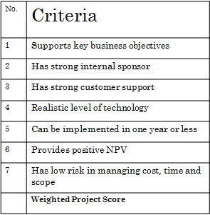


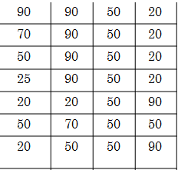
Since Project 2 has the highest weighted project score, it is the winner!

Slide 33
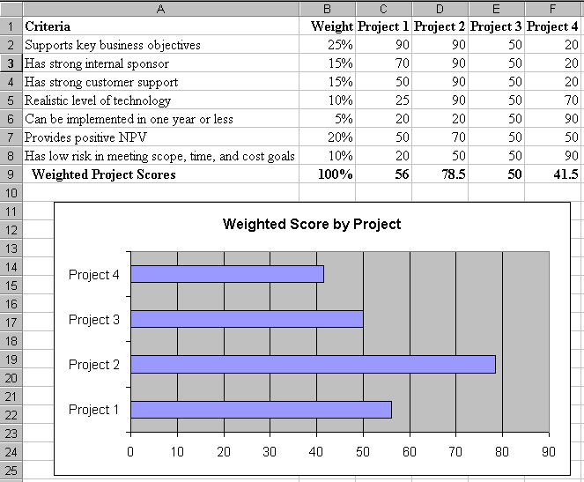
SAMPLE WEIGHTED SCORING MODEL FOR PROJECT SELECTION

Slide 34
I thank you.

